Slide 1
BINARAY LOGISTIC REGRESSION MODEL CROSS VALIDATION IN PYTHON

Slide 2
Contents
Cross Validation
Hold out validation
Performance Measures : Accuracy, Recall, Precision
K-fold validation

Slide 3
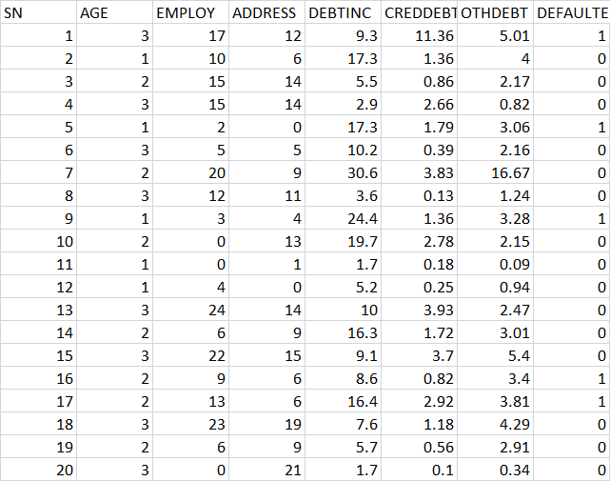
Recap:Data Snapshot
Independent Variables
Dependent Variable
Column | Description | Type | Measurement | Possible Values
SN | Serial Number | numeric | - | -
AGE | Age Groups | Categorical | 1(<28 years), 2(28-40 years), 3(>40 years) | 3
EMPLOY | Number of years customer working at current employer | Continuous | - | Positive value
ADDRESS | Number of years customer staying at current address | Continuous | - | Positive value
DEBTINC | Debt to Income Ratio | Continuous | - | Positive value
CREDDEBT | Credit to Debit Ratio | Continuous | - | Positive value
OTHDEBT | Other Debt | Continuous | - | Positive value
DEFAULTER | Whether customer defaulted on loan | Binary | 1(Defaulter), 0(Non-Defaulter) | 2
Observations

Slide 4
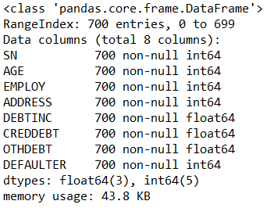
Binary Logistic Regression in Python
# Import data and check data structure before running model
import pandas as pd bankloan=pd.read_csv('BANK LOAN.csv') bankloan.info()
# Output:

Slide 5
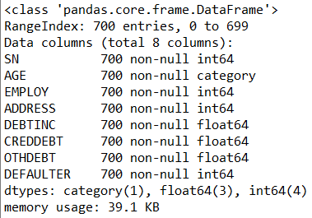
Binary Logistic Regression in Python
# Change ‘AGE’ variable into categorical
Age is an integer and need to convert into type “category” for modeling purpose.
bankloan['AGE']=bankloan['AGE'].astype('category') bankloan.info()
# Output:

Slide 6
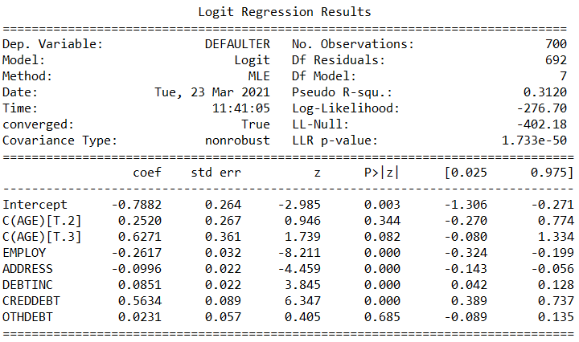
Binary Logistic Regression in Python
# Logistic Regression using logit function
import statsmodels.formula.api as smf riskmodel = smf.logit(formula = 'DEFAULTER ~ AGE + EMPLOY + ADDRESS + DEBTINC + CREDDEBT + OTHDEBT', data = bankloan).fit()
logit() fits a logistic regression model to the data.
# Model summary
summary() generates detailed summary of the model.
riskmodel.summary()
Interpretation :
Since p-value is <0.05 for Employ, Address, Debtinc, Creddebt, these independent variables are significant.

Slide 7
Re-run Model in Python
Once the variables to be retained are finalized, re-run the model with these final variables and obtain revised coefficients for the model.
Re-run the model with employ, address, debtinc, creddebt.
riskmodel = smf.logit(formula = 'DEFAULTER ~ EMPLOY + ADDRESS + DEBTINC + CREDDEBT', data = bankloan).fit() riskmodel.summary()

Slide 8
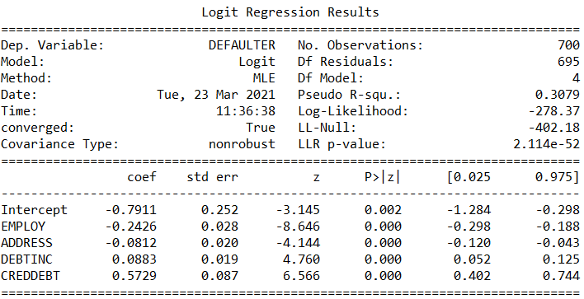
Re-run Model in Python
# Output:
Interpretation :
Since p-value is <0.05 for Employ, Address, Debtinc and Creddebt, these independent variables are significant.

Slide 9
Cross Validation in Predictive Modeling
Cross Validation is a
process of evaluating the model on
‘Out of Sample’ data
Model performance measures for binary logistic regression such as Accuracy rate, Sensitivity, Specificity tend to be optimistic on 'In Sample Data'
More realistic measures of model performance are calculated using "Out of Sample' data
Cross-validation is a procedure for estimating the generalization performance in this context
Cross validation is important because although a model is built on historical data, ultimately it is to be used on future data. However good the model, if it fails on out of sample data then it defeats the purpose of predictive modeling

Slide 10
Cross Validation in Predictive Modeling
There are different approaches for cross validation. Five most significant of them are:
We will focus on Hold Out and K-Fold Cross validation methods.
Hold-Out Validation
K-Fold Cross Validation
Repeated K-Fold Cross Validation
Resampling Validation Method (Bootstrap Method)
Leave-One-Out Cross Validation (LOOCV)

Slide 11
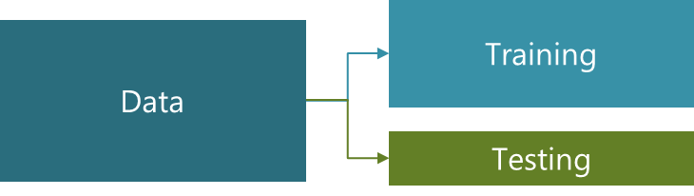
Hold-Out Validation
In Hold-Out validation method, available data is split into two non-overlapped parts: 'Training Data' and 'Testing Data'
The model is
Developed using training data
Evaluated using testing data
Training data should have more sample size. Typically 70%-80% data is used for model development
*
Here we continue to use previous data of bank loan for our further analysis.

Slide 12
Hold Out Validation in Python
# Create 2 groups of the data: Training and Testing
import pandas as pd import numpy as np from sklearn.model_selection import train_test_split import statsmodels.formula.api as smf bankloan=pd.read_csv('BANK LOAN.csv') X_train, X_test = train_test_split(bankloan, test_size=0.3)
Import train_test_split from sklearn.model_selection
train_test_split() creates Training and Testing data sets
test_size= is the percentage of data to be kept as test data

Slide 13
Hold Out Validation in Python
# Check the dimensions training and testing data
X_train.shape
# Output:
X_test.shape
# Output:
The data of 700 observations are partitioned into 2 parts:
With 490 observations in training (model development) data and
remaining 210 observations in testing data (out of sample).

Slide 14
Hold Out Validation
Model will be run on the training data and predicted probabilities will be generated.
Same model will be applied to test data to get the predicted probabilities.
Classification Report will be used to check the performance of the model in training and testing data.

Slide 15



Performance Measures : Accuracy, Precision, Recall
Accuracy : Accuracy is defined as the ratio of correctly predicted cases by the total cases.
Precision : Precision tells us what percentage of predicted positive cases are correctly predicted.
Recall or Sensitivity : Recall tells us what percentage of actual positive cases are correctly predicted.

Slide 16
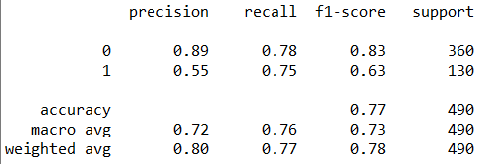
Performance Measures in Python
# Generate classification report for training data
riskmodel=smf.logit(formula = 'DEFAULTER ~ EMPLOY + ADDRESS + DEBTINC + CREDDEBT', data = X_train).fit() predicted_values1=riskmodel.predict() threshold=0.3 predicted_class1=np.zeros(predicted_values1.shape) predicted_class1[predicted_values1>threshold]=1 from sklearn.metrics import classification_report print(classification_report(X_train['DEFAULTER'],predicted_class1))
# Output:

Slide 17
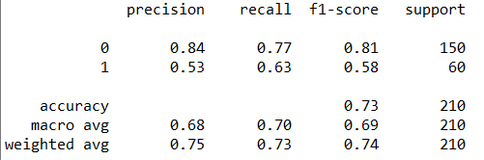
Performance Measures in Python
# Generate classification report for test data
predicted_values1=riskmodel.predict(X_test)
threshold=0.3
predicted_class1=np.zeros(predicted_values1.shape)
predicted_class1[predicted_values1>threshold]=1
print(classification_report(X_test['DEFAULTER'],predicted_class1))
# Output:
Interpretation :
Accuracy & Sensitivity of test data is lower than that of train data. However, the values are still acceptable.

Slide 18
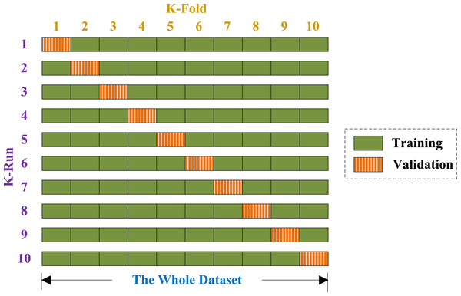
K fold Cross Validation
In k-fold cross-validation the data is first partitioned into k equally (or nearly equally) sized segments or folds.
Then k iterations of training and testing are performed such that each time one fold is kept aside for testing and model is developed using k-1 folds.

Slide 19
K-fold Validation in Python
# Create k-folds
from sklearn import linear_model lmreg = linear_model.LogisticRegression() y=bankloan.DEFAULTER X=bankloan[['EMPLOY', 'ADDRESS', 'DEBTINC', 'CREDDEBT']] from sklearn.model_selection import cross_val_predict from sklearn.metrics.classification import cohen_kappa_score predicted_prob = cross_val_predict(lmreg, X, y, cv=4, method='predict_proba') threshold=0.3 predicted = predicted_prob[:,1] predicted_class1=np.zeros(predicted.shape) predicted_class1[predicted>threshold]=1
cross_val_predict() generates cross-validated estimates for each input data point.
method=‘predict_proba’ calculates probabilities for both classes.
cv=4 specifies 4 folds

Slide 20
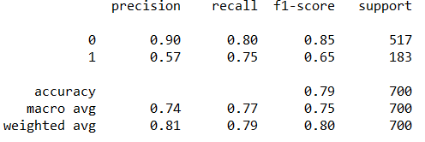
K-fold Validation in Python
# Generate classification report for k-fold validation
print(classification_report(y,predicted_class1))
classification_report() : gives accuracy, recall and precision values
# Output:
Interpretation : accuracy of 0.79 and recall of 0.75 indicate that the model is performing good.

Slide 21
Quick Recap
In this session, we learnt about Model Validation :
Cross Validation
Cross Validation is a process of evaluating the model on ‘Out of Sample’ data.
Hold out validation
In Hold-Out validation method, available data is split into two non-overlapped parts: 'Training Data' and 'Testing Data’.
Performance Measures
Performance measures like Accuracy, recall & precision are calculated to check model performance of train & test data.
classification_report() gives all these measures
K-fold validation
In k-fold cross-validation the data is first partitioned into k equally (or nearly equally) sized segments or folds.
Then k iterations of training and testing are performed such that each time one fold is kept aside for testing and model is developed using k-1 folds.

Slide 22
THANK YOU!!

